Slide 1




Slide 2

Employee Burnout Prediction Analysis
In this presentation, discover how my analysis helps companies predict employee burnout before it happens, the factors that contribute to it and the impact it has on both employees and organizations.

Slide 3
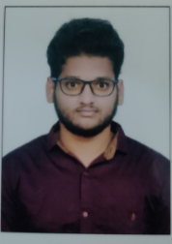
Student Details
1
Name
2
Skills Build Email ID
3
College Name
4
College State
Yuva Sri Kishore Kumar Amujuri
kishorekumar110102@gmail.com
Pragati Engineering College
Andhra Pradesh
5
Internship Domain and Internship Start and End Date
Artificial Intelligence ( 05-06-2023 to 15-07-2023 )

Slide 4
Project Title
Employees Burnout Analysis and Prediction
Problem Statement
Develop a model to predict employee burnout rate based on various factors and explore potential solutions to mitigate burnout risks.

Slide 5
Agenda
Project Overview
End Users of the Project
Your Solution and its Value Proposition
How did you Customize the Project and Make it Your Own
Modelling
Results

Slide 6
Project Overview
1
The Problem
2
The Solution
3
The Result
Employee burnout is a major problem in many companies, leading to high turnover and lost productivity.
The project focuses on analyzing a dataset that includes various factors known to contribute to employee burnout, such as WFH Setup Available, Burn Rate and Mental Fatigue Score
The project aims to provide HR managers and team leaders with valuable information to make informed decisions.

Slide 7
End Users of the Project
1
HR Managers
2
Company Leaders
3
Employees
Responsible for monitoring employee well-being and reducing turnover.
Invested in improving productivity and profitability through employee satisfaction.
Benefit from a healthier and more sustainable workplace culture.

Slide 8
Your Solution and its Value Proposition
1
Predictive Models
2
Data Visualization
3
Ingenious Strategies
I developed a machine learning model that predicts employee burnout risk based on various factors, such as WFH Setup Available, Burn Rate and Mental Fatigue Score
I created interactive visualizations of my data, providing insights into the relationships between different variables and their impact on burnout.
Based on my findings, I developed effective intervention strategies to prevent burnout, such as flexible work arrangements and mental health support. These strategies can save businesses money in lost productivity and employee turnover.

Slide 9
How did you Customize the Project and Make it Your Own
1
Dataset Collection
2
Models That Used
3
Adaptable Insights
Employees across different industries and professions, ensuring a diverse dataset form Kaggle that accurately represents the workforce.
I used machine learning algorithms models such as Linear Regression, Ada Boosting Regressor and Random Forest and customized them to fit my specific dataset, resulting in a more accurate predictive model.
I went beyond the obvious factors that contribute to burnout, such as Company Type, WFH Setup Available , Designation and Resource Allocation explore other important variables, such as Burn Rate and Mental Fatigue Score

Slide 10
Modelling
1
Data Sources
2
Data Cleaning
3
Model Training
I gathered data from multiple sources including HR databases, productivity software, and employee surveys.
I performed extensive data cleaning to remove errors, inconsistencies, and missing values.
I used supervised learning algorithms to train my models on dataset, constantly learning from new data to improve accuracy over time.
4
Evaluation Metrics
I evaluated the performance of my models using r2_score that predicts the accuracy of the models.

Slide 11
Results
r2_score for Linear Regression 83.171%
r2_score for Random Forest Regressor 91.342%
r2_score for Ada Boosting Regressor 80.213%
Top 3 predictors WFH Setup Available, Burn Rate and Mental Fatigue Score
Overall, the goal of this project was to build a models that could accurately predict burnout risk and potentially be used by organizations to prevent burnout and promote the well-being of their employees.

Slide 12
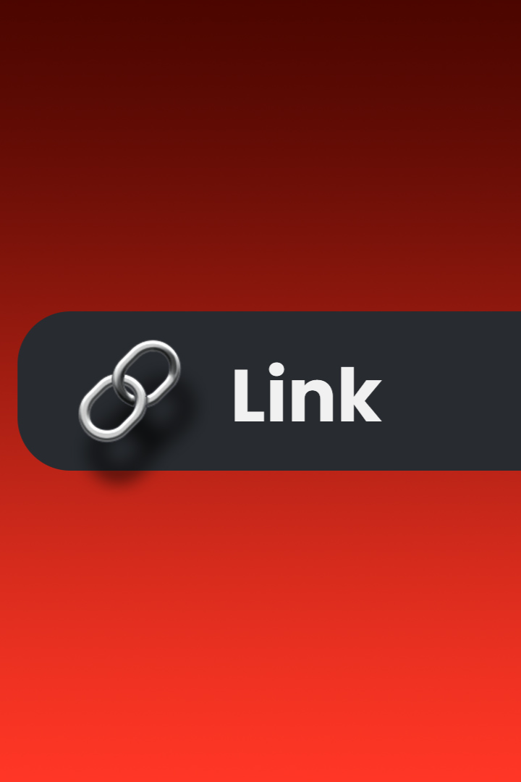
Links
Here are links to the code and the dataset that I used in this Project.
Link for Code
Link for dataset
​​inkhttps://drive.google.com/drive/folders/1FJ8vhrxTbzjiGJ6VMxoCuOh4t6FCJbF6?usp=sharing
​https://www.kaggle.com/code/gcdatkin/employee-burnout-prediction

Slide 13

ThankYou :)

